Slide 1

1
NOMA Mobility Support
SEMINAR
Varsha U
MAC22MCA-2028
Faculty guide : Prof.Sonia Abraham

Slide 2
2
Outline
INTRODUCTION
EVOLUTION OF ACESS TECHNIQUE
NOMA
CHALLENGES WITH USER MOBILITY
SYSTEM MODEL
RE-ASSOCIATION METHODS
CONCLUSION

Slide 3
3
Outline
INTRODUCTION
Context
Motivation
EVOLUTION OF ACESS TECHNIQUE
NOMA
CHALLENGES WITH USER MOBILITY
SYSTEM MODEL
RE-ASSOCIATION METHODS
CONCLUSION

Slide 4
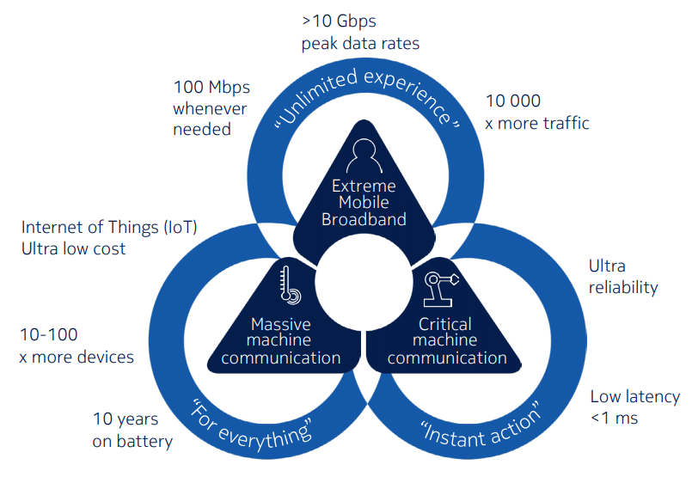
4
Context
5G enables new capabilities beyond mobile broadband

Slide 5
5
Context
Motivation
In wireless communication, The Non-Orthogonal Multiple Access (NOMA) allows to serve multiple users on the same time and frequency resource .
NOMA is a promising technology
Increase network spectral efficiency
Support massive connectivity
Improve cell edge users performance
Complex decoding at the receiver
Focus Area:
Optimization of NOMA in dynamic wireless environments.
5G enables new capabilities beyond mobile broadband

Slide 6
6
Outline
INTRODUCTION
EVOLUTION OF ACESS TECHNIQUE
Common types of Multiple access
NGN Challenges
NOMA
CHALLENGES WITH USER MOBILITY
SYSTEM MODEL
RE-ASSOCIATION METHODS
CONCLUSION

Slide 7
7
Common types of Multiple access
1G :Frequency-division multiple access (FDMA).
2G: Time-division multiple access (TDMA).
3G: Code-division multiple access (CDMA).
4G: Orthogonal frequency division multiple access (OFDMA)
Next-Generation Wireless Networks (NGN) Challenges
Addresses bandwidth, latency, security, and interoperability issues.

Slide 8
8
Outline
INTRODUCTION
EVOLUTION OF ACESS TECHNIQUE
NOMA
Introduction to NOMA
Concept of NOMA
Uplinking in NOMA
Downlinking in NOMA
User Pairing in NOMA
CHALLENGES WITH USER MOBILITY
SYSTEM MODEL
RE-ASSOCIATION METHODS
CONCLUSION

Slide 9
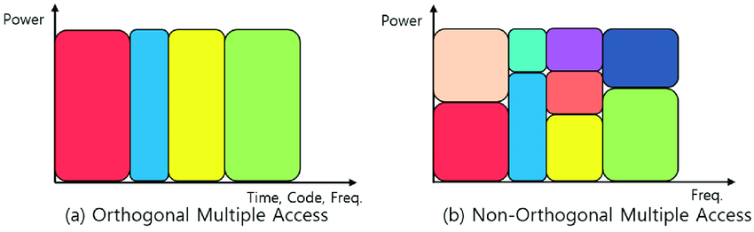
9
Introduction to NOMA
Non-Orthogonal Multiple Access (NOMA) revolutionizes spectral efficiency by allowing shared time-frequency resource blocks among users.

Slide 10
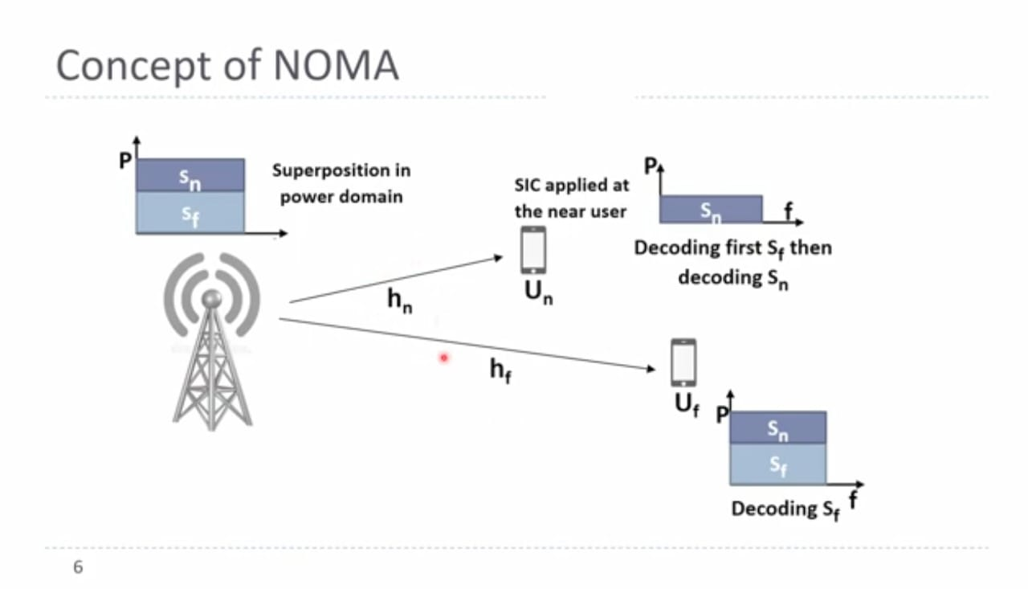
10

Slide 11
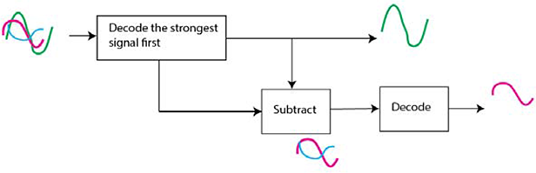
11
Uplinking in NOMA
1
Power Domain Multiplexing
Users transmit at different power levels based on channel conditions.
2
Successive Interference Cancellation
SIC decodes signals starting with the strongest.
Notes:
In NOMA (Non-Orthogonal Multiple Access), the uplink involves multiple users transmitting data to a common receiver, such as a base station, over the same frequency-time resource.
In the uplink scenario we have:
• Power Domain Multiplexing: Users send their data using different power levels allocated by the base station. This allocation is based on each user’s channel conditions, assigning lower power to users with better channel conditions and higher power to users experiencing weaker channels. This power allocation is critical in ensuring that signals can be separated at the receiver.
• Successive Interference Cancellation (SIC): At the receiver, SIC plays a crucial role. It decodes the signals one by one, starting with the user transmitting the strongest signal. Once the strongest signal is decoded and removed, the receiver proceeds to decode the next strongest signal. This iterative process continues until all the users’ signals are successfully recovered.
image

Slide 12
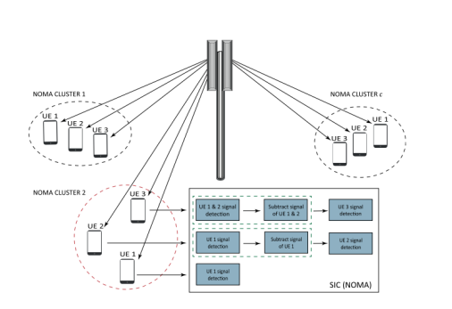
12
Downlinking in NOMA
Power Allocation
Superposition Coding
Successive Interference Cancellation
Base station assigns power based on user channel conditions.
Combines multiple users' data into a single signal.
SIC at user equipment decodes signals based on channel quality.
Fig. 1. A downlink NOMA system with multiple clusters.
Notes:
In NOMA (Non-Orthogonal Multiple Access), the downlink involves a base station transmitting data to multiple users over the same frequency-time resource.
downlink processes involve
• Power Allocation: Similar to the uplink, the base station allocates different power levels to users based on their channel conditions. Users with better channels may receive lower power, while those with weaker channels are assigned higher power levels. This power allocation aims to optimize the overall spectral efficiency.
• Superposition Coding: The base station uses a technique called superposition coding to combine multiple users’ data into a single composite signal. This composite signal contains the individual data intended for each user, superimposed onto each other.
• Successive Interference Cancellation (SIC): SIC is employed at the user equipment side to decode and remove the signals of users with better channel conditions first, followed by decoding the signals of users with weaker channels.
image

Slide 13
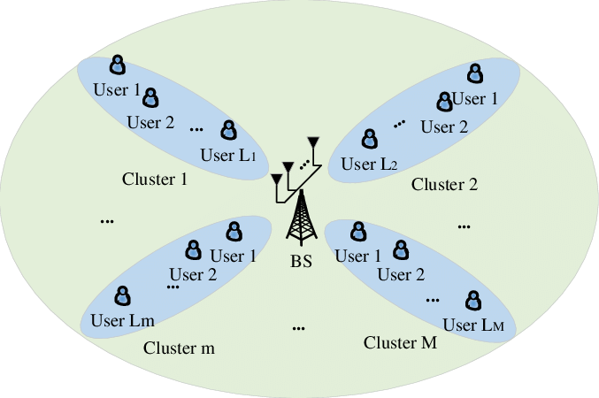
13
User Pairing in NOMA
1
Enhanced Gain Difference
2
Spectral Efficiency
Pairing users with distinct channel conditions optimizes NOMA techniques.
Appropriate pairing improves system capacity and efficiency.
3
SIC Effectiveness
Gain difference aids in effective SIC, enhancing
decoding performance.
Notes:
Extra system demand and error risk
Sufficient
It is important because of mainly
Enhanced Gain Difference:
. Pairing users with diverse channel conditions creates a noticeable difference in their communication strengths within a cluster.
This difference in strength is vital for making NOMA techniques, like superposition coding and successive interference cancellation (SIC), work effectively. It allows for better coding and decoding of signals.
Spectral Efficiency:
Spectral efficiency is like how efficiently the available communication resources are used. User pairing directly affects this efficiency.
By pairing users based on their channel conditions, NOMA can efficiently combine their signals. This means that multiple users can transmit at the same time in the same resource block, making the system more efficient.
SIC Effectiveness:
User pairing helps for the easy performance of sic. Users with stronger signals (higher channel gains) can be decoded first. Their signals are then removed before decoding signals from users with weaker signals. This stepwise cancellation relies on the gain difference and results in better overall decoding performance.

Slide 14
14
Outline
INTRODUCTION
EVOLUTION OF ACESS TECHNIQUE
NOMA
CHALLENGES WITH USER MOBILITY
SYSTEM MODEL
RE-ASSOCIATION METHODS
CONCLUSION

Slide 15
15
Challenges with User Mobility
1
Channel Gain-Difference Impact
User mobility causes fluctuations in channel conditions altering the gain differences between users within a cluster.
2
Incorrect User Pairing
Mobility introduces dynamic changes in channel conditions, leading to potential mismatches in user pairing.
3
Re-Clustering Necessity
To mitigate the impact of user mobility and maintain efficient NOMA operation, re-clustering methods become essential.
Notes:
User mobility refers to the ability of users or devices to move within a wireless communication network while maintaining connectivity.
In the context of NOMA,user mobility becomes a significant factor influencing the performance of the communication network.
User mobility introduces several challenges in NOMA
1. **Channel Gain-Difference Impact:**
- As users move within the communication network, their positions relative to the base station change. This mobility causes fluctuations in channel conditions, leading to variations in the gain differences between users within a cluster.
2. **Incorrect User Pairing:**
- **Explanation:** Mobility introduces dynamic changes in channel conditions, making it challenging to maintain the accuracy of user pairing. Users initially paired for optimal gain differences might experience altered channel conditions due to their movement.
It can significantly diminish the effectiveness of NOMA. The success of NOMA techniques, such as SIC and superposition decoding, relies on accurate user pairing. Mismatched pairs reduce the benefits of these techniques, ultimately degrading the overall system performance.
3. **Re-Clustering Necessity:**
- **Explanation:** To address the challenges posed by user mobility and to ensure the continued efficiency of NOMA operation, re-clustering methods become essential. These methods dynamically, adjust user clusters, based on updated channel information or observed mobility patterns.
- **Impact:** Re-clustering allows for the realignment of users into clusters, that optimize gain differences under the current channel conditions. This dynamic adjustment enhances spectral efficiency

Slide 16
16
Outline
INTRODUCTION
EVOLUTION OF ACESS TECHNIQUE
NOMA
CHALLENGES WITH USER MOBILITY
SYSTEM MODEL
Association
Dissociation
Re-association
RE-ASSOCIATION METHODS
CONCLUSION

Slide 17
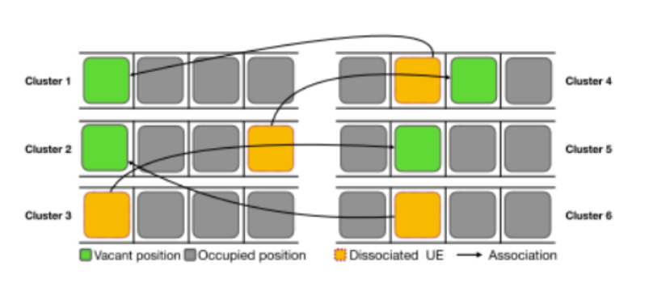
17
System Model
1
User Association
Optimizes performance by managing UE connections.
2
Dissociation
Removes UEs from clusters when channel conditions
degrade.
3
Re-association
Integrates dissociated UEs into new clusters.
Notes:
When a device, like our phone, enters the NOMA system, it begins without being connected. It looks around for groups of users (clusters) and picks the one with the strongest signal. The device then asks to join that group (association request), and if accepted, it gets a designated spot in the cluster. Now, it's part of the group and can use the services provided.
Dissociation happens when the connections between devices within a cluster start causing issues. If the signals between devices get too messy, NOMA needs to separate some devices from the cluster. This is important because it helps maintain the efficiency of techniques like Successive Interference Cancellation (SIC). Dissociation ensures that devices with poor connections are separated, allowing the remaining devices in the cluster to work well together.
Re-association comes into play when devices are separated from their original clusters due to poor connections. The goal is to find new, better clusters for these devices. Re-association looks for groups where the channel conditions are suitable for techniques like SIC. It's like rearranging devices to form new, efficient groups that support simultaneous transmission and reception.
image

Slide 18
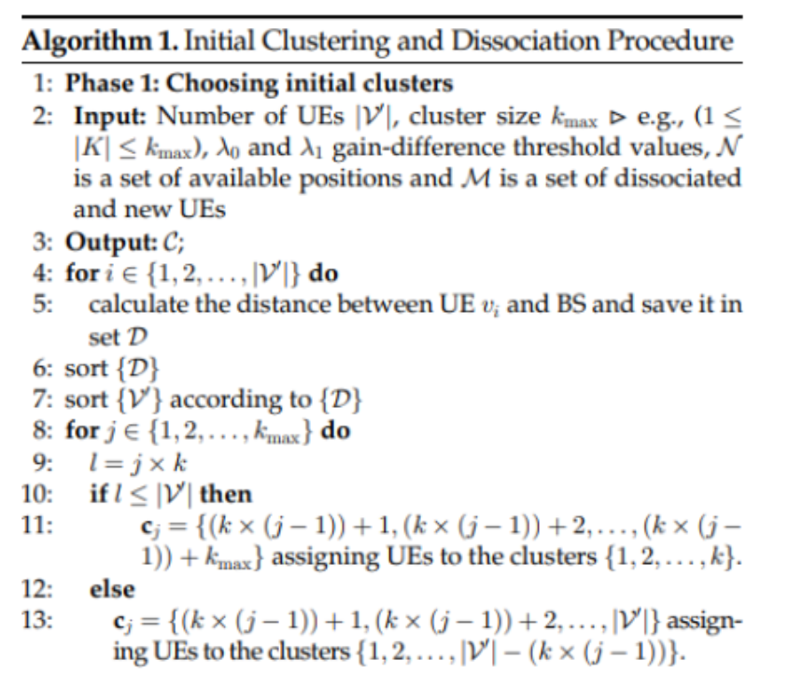
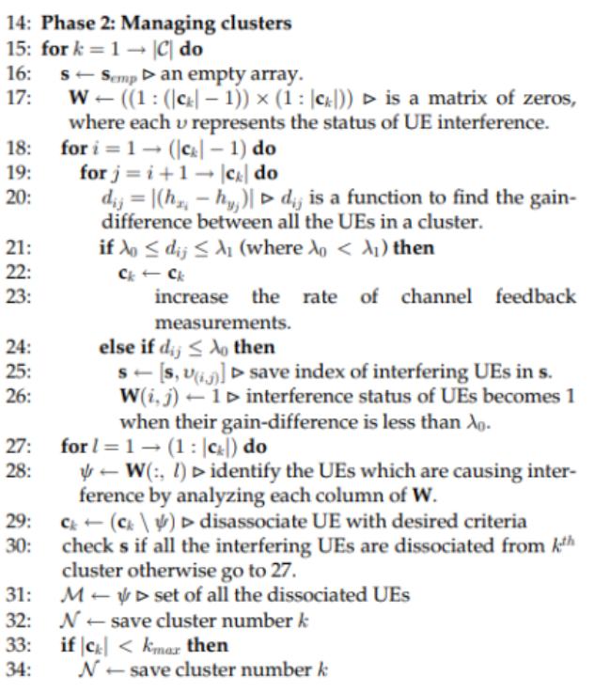
18
Algorithm
Notes:
Phase 1:
Choosing initial clusters: first it calculates the distance between each UE and base station (BS).It then sorts the UEs based on this distance.Finally, the algorithm creates a predetermined number of clusters (kmax) by assigning a fixed number of UEs (determined by k) to each cluster, starting from the closest UEs to the BS.This is the first stage of cluster formation. The algorithm further refines the clusters in next phase by reassigning Ues for better resourse utilization
phase 2- a backtracking procedure is applied to continuously monitor and update the clusters created in phase 1. . It iterates through each cluster and compares the gain difference between all the UEs within the cluster..If the gain difference is lower than certain threshold, the algorithm considers the UEs to be interfering with each other. It then removes the interfering UEs from the cluster and marks them for further action.Overall, the algorithm separate UEs within a cluster based on their signal strength to potentially improve network performance.these dissociated users are assigned to new suitable positions in other clusters.
it can be done using

Slide 19
Outline
19
INTRODUCTION
EVOLUTION OF ACESS TECHNIQUE
NOMA
CHALLENGES WITH USER MOBILITY
SYSTEM MODEL
RE-ASSOCIATION METHODS
Arbitrary Method
One-by-One Method
Kuhn-Munkres Assignment Algorithm(KMAA) Method
CONCLUSION

Slide 20
20
Re-association Methods
1
2
3
Arbitrary
One-by-One
KMAA
Randomly assigns users to new clusters.
Sequentially evaluates and places users.
Uses Hungarian algorithm for optimal pairings.
Notes:
To keep the system running smoothly.
These methods differ in how the pick suitable host clusters for users who got disconnected.
The Arbitrary Method is a simple way of putting disconnected users back into clusters.
When users get disconnected because of bad signal, this method randomly assigns them to clusters that meet specific rules. These rules often relate to keeping a certain level of signal quality difference between users.
It's easy because it follows a basic rule:
put disconnected users in clusters that ensure a certain signal quality difference.
It's quick to set up and doesn't need a lot of complicated calculations.
Drawback is that it might not be the best at optimizing the performance of the network. It doesn't make sure the signal quality is just right in all clusters, which can lead to not using resources efficiently.
It's good for situations where you need to make decisions fast and don't have a lot of computing power. It's about quickly getting users back into the network rather than making everything perfect.

Slide 21
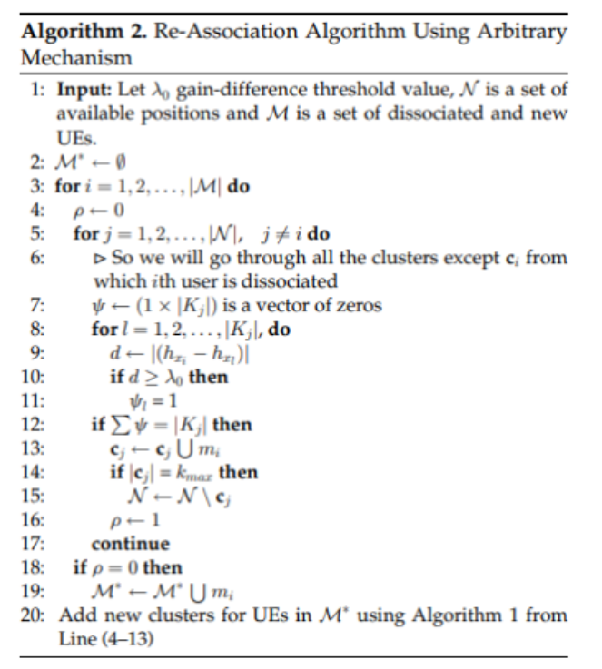
21
Notes:
For each UE in the set of dissociated UEs (M)
Iterate through all clusters in set N except the cluster from which the UE was dissociated (Lines 4-6).
Check the gain difference between the UE and each UE in the cluster (Lines 7-11).
If the gain difference is above a certain threshold (0), assign the UE to the cluster (Lines 12-15).
Update sets M' and N accordingly (Lines 16-19).
If there are still UEs in M', add new clusters for them using Algorithm 1.

Slide 22
22
Re-association Methods
1
2
3
Arbitrary
One-by-One
KMAA
Randomly assigns users to new clusters.
Sequentially evaluates and places users.
Uses Hungarian algorithm for optimal pairings.
Notes:
The One-by-One Re-association Method is more organized.
When users get disconnected, this method looks at each user separately. It then finds the best clusters based on specific rules for signal quality.
Unlike the Arbitrary Method, this approach aims for a more precise allocation, by checking the signal quality difference between a disconnected user and possible clusters. It prioritizes the cluster that offers the highest signal quality difference within certain limits.
It's a bit more complex , because it takes the time to carefully check each disconnected user and put them in clusters ,with the best signal quality difference. This helps make sure that the clusters work really well together, making communication through NOMA more efficient.
It's good for situations where you can afford a bit more time and computing power to make sure the network is working at its best. It's about making sure everything is optimized for the best performance.

Slide 23
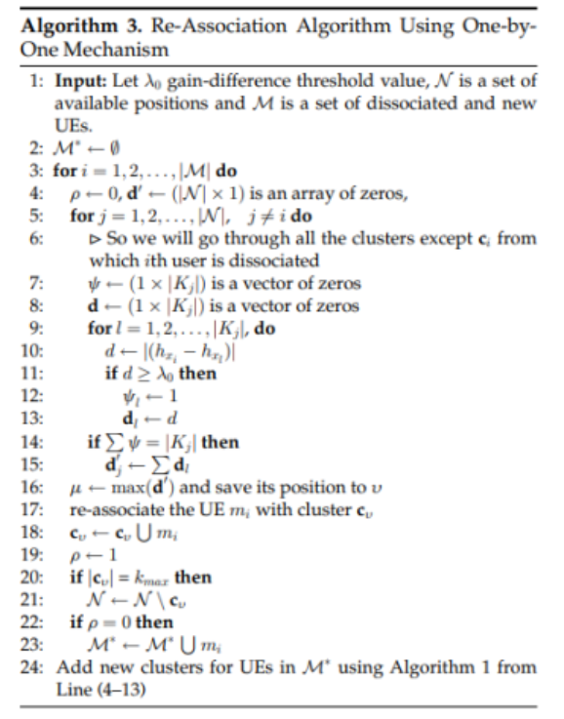
23
Notes:
For each user in the set of dissociated UEs (M),
it Iterate through all clusters in set , except the cluster from which the users was dissociated (Lines 4-6).
Check the gain difference between the UE and each UE in the cluster (Lines 7-12).
Identify the cluster with the maximum gain difference and re-associate the UE with that cluster (Lines 13-18).
Update sets M' and N accordingly (Lines 19-23).
If there are still UEs in M', add new clusters for them using Algorithm 1.

Slide 24
24
Re-association Methods
1
2
3
Arbitrary
One-by-One
KMAA
Randomly assigns users to new clusters.
Sequentially evaluates and places users.
Uses Hungarian algorithm for optimal pairings.
Notes:
The Kuhn-Munkres Assignment Algorithm (KMAA), also known as the Hungarian algorithm,it is a sophisticated way of reconnecting users, who got disconnected in wireless networks.
It focuses on making the best pairings between users and clusters based on their channel conditions. This method is more complex compared to others but is highly efficient.
The KMAA method creates a cost matrix, representing the connection between disconnected users and available clusters. Each element in the matrix shows the cost , or gain difference between a disconnected user and a specific cluster. The algorithm then finds the best pairings , by identifying the maximum gain
. The goal is to match, each disconnected user with the most suitable cluster.
It offers a more optimized approach compared to simpler methods. It maximizes gain differences within predefined thresholds, ensuring, that the network operates at its best efficiency.
It's ideal for situations where we can invest more computational resources to achieve the best possible network performance.

Slide 25
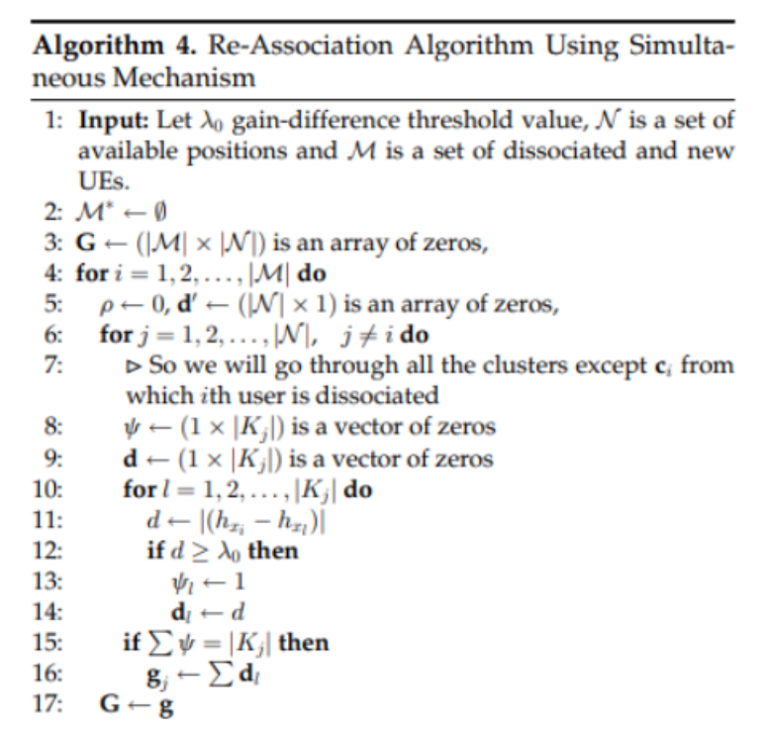
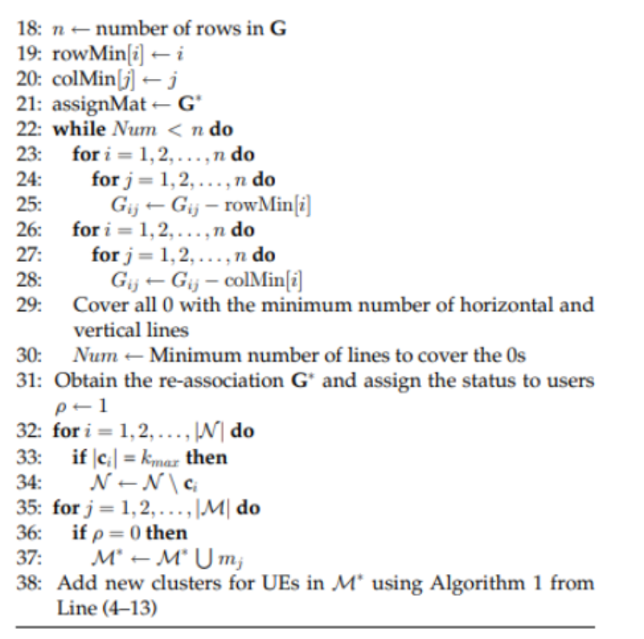
25
Notes:
The algorithm takes three inputs:
A threshold value (Xo),A set of available positions (N),A set of users (M) that are either dissociated from a previous cluster or new users
The algorithm loops through each user in the set , and also through all the positions , except for the position the user was previously associated with.
the algorithm finds the distance between the user and each position.
It calculates a score based on the minimum distance. If the distance is less than the threshold value (Xo), the score is incremented by 1
Once all the scores are calculated, the algorithm finds the position with the highest score for each user. This position is considered the best association for that user.
if there are any users that are not assigned to any position. it creates new clusters for them.

Slide 26
26
Outline
INTRODUCTION
EVOLUTION OF ACESS TECHNIQUE
NOMA
CHALLENGES WITH USER MOBILITY
SYSTEM MODEL
RE-ASSOCIATION METHODS
CONCLUSION

Slide 27
27
Conclusion
This research addresses the critical challenge of user mobility within wireless networks. We have introduced innovative solutions, such as the Kuhn-Munkres Assignment Algorithm, to ensure efficient clustering and seamless connectivity. This work paves the way for more robust, high-capacity, and reliable Next-Generation Wireless Networks.
Unlocking the Potential
Innovative Cluster Solution
Expanded Applicability
Future Investigations
Optimization Objective
Notes:
In summary, our seminar looked at the evolution of wireless networks, moving from old methods to the advanced Non-Orthogonal Multiple Access (NOMA) systems. We learned about the limits of older technologies and the need for improvements in wireless communication.
We explored NOMA's important features, like boosting efficiency by letting multiple users share resources simultaneously. We focused on encoding methods at the sender and Successive Interference Cancellation (SIC) at the receiver, showing how NOMA maximizes channel use and reduces interference.
Despite NOMA's strengths, we acknowledged challenges like user movement, changing channels, and the importance of accurate user pairing in NOMA clusters. We also saw the need for strong methods to adapt to dynamic network changes.
There is an ongoing need for research and innovation in this fast-changing field.
;
;
;
more research in NOMA mobility support can help us learn more and improve the future of communication systems.
NOMA technology is still evolving. Areas like power control algorithms, receiver complexity, and user fairness require further refinement.
As NOMA matures and standardization progresses, it's expected to be adopted more widely in 5G and beyond 5g networks .

Slide 28
28
References
• Naeem, Muhammad Kamran, et al. "Mobility Support for MIMO-NOMA User Clustering in Next-Generation Wireless Networks." IEEE Transactions on Mobile Computing (2022).
• Naeem, Muhammad Kamran, et al. "Towards the mobility issues of 5G-NOMA through user dissociation and re-association control." 2020 IEEE 21st International Symposium on" A World of Wireless, Mobile and Multimedia Networks"(WoWMoM). IEEE, 2020.
• Kim, Ha-Ryung, Jiasi Chen, and Jongwon Yoon. "Joint user clustering and beamforming in non-orthogonal multiple access networks." IEEE Access 8 (2020): 111355-111367

Slide 29
29
THANK YOU

